Slide 1
M O D U L E - 2

Slide 2
M O D U L E - 2
2.1. PROCESS FRAMEWORK MODELS
2.1.1 Capability maturity model (CMM)
2.1.2 ISO 9000
2.2 PHASES IN SOFTWARE DEVELOPMENT
2.2.1 Requirement analysis
2.2.2 Requirements elicitation for software
2.2.3 Analysis principles
2.2.4 Software prototyping
2.2.5 Requirement Specification

Slide 3
1. P R O C E S S F R A M E W O R K

Slide 4
I N T R O D U C T I O N
Process framework establishes the foundation for a complete software process
It identifies a small no: of framework activities that are applicable to all software projects
It encompasses a set of umbrella activities, that are applicable to entire s/w process

Slide 5
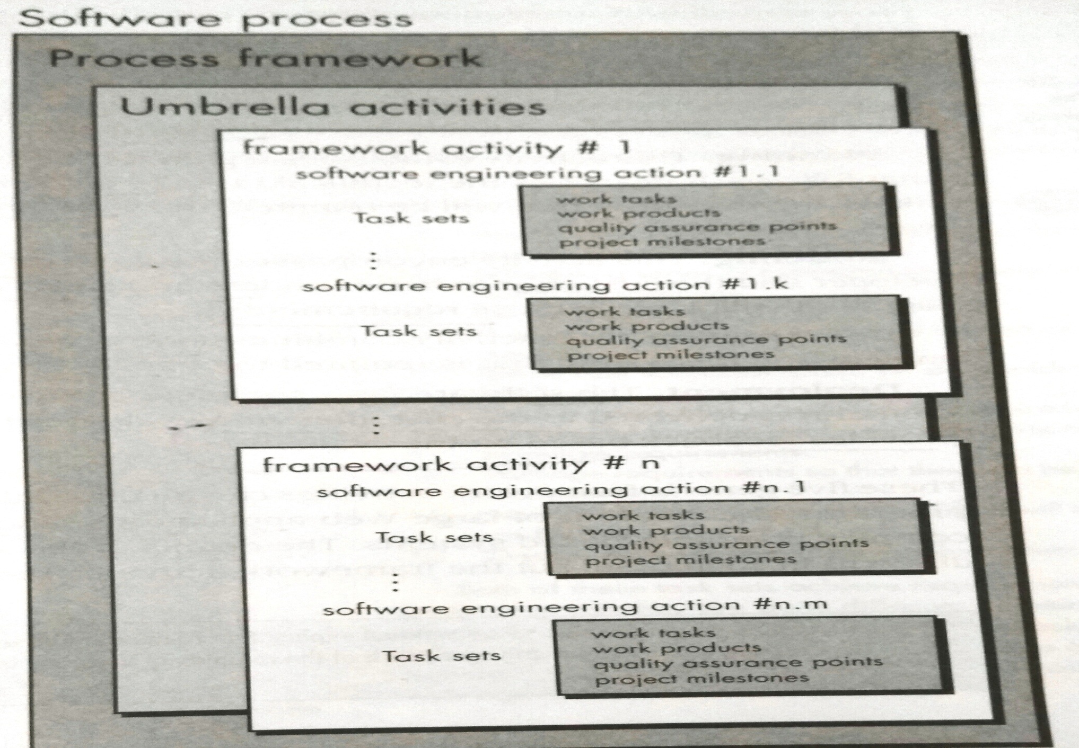
S O F T W A R E P R O C E S S F R A M E W O R K

Slide 6
U M B R E L L A A C T I V I T I E S
Umbrella activities
It encompasses a set of framework activities
Framework activities
Each framework activity consist of a set of software engineering actions
Software engineering action:
It is a collection of related tasks set that produces a major s/w engineering work product
E.g.: Design, Requirement gathering
Each engineering action is populated with individual work tasks

Slide 7
Task set
It defines the actual work to be done to accomplish the objectives of software engineering action
It is a collection of
Software engineering work tasks
Related work products
Quality assurance points
Project milestones

Slide 8
E X A M P L E
E.g.: If Requirement gathering is a software engineering action, then task set of requirement gathering is
Make a list of stakeholders of project
Invite stakeholders to an informal meeting
Ask each stakeholders to make a list of features & functions required
Discuss requirements and build final list
Prioritize requirements
Note the areas of uncertainty

Slide 9
5 G E N E R I C P R O C E S S F R A M E W O R K A C T I V I T I E S
These activities are applicable to majority of software projects
Can be used during development of small pgms, large web applications, complex computer based s/m
Details of s/w process will be different but the framework activities remains the same
[A]. Communication
[B]. Planning
[C]. Modeling
[D]. Construction
[E]. Deployment

Slide 10
[A]. C O M M U N I C A T I O N
This activity involves heavy communication & collaboration with customer & other stakeholders
Encompasses requirement gathering & other related activities

Slide 11
[B]. P L A N N I N G
This activity establishes a plan for the software engineering work
It describes
Technical tasks to be conducted
The risks that are likely to happen
Resources required
Work product to be produced
Work schedule

Slide 12
[C]. M O D E L I N G
This activity encompasses the creation of models
It allows the developer & customer to understand the software requirements & design
It is composed of 2 software engineering actions
Analysis
Design

Slide 13
[C]. M O D E L I N G
Analysis
It consists of set of work tasks that lead to the creation of analysis model or requirement specification
Set of tasks include
Requirement gathering
Elaboration
Negotiation
Specification
Validation

Slide 14
[C]. M O D E L I N G
Design
Encompasses work tasks that create a design model
Tasks are:
Data design
Architectural design
Interface design
Component level design

Slide 15
[D] C O N S T R U C T I O N
This activity combines the code generation & testing, which is required to uncover the errors in the code

Slide 16
[E]. D E P L O Y M E N T
Software is delivered to the customer who evaluates the delivered product
Provides feedback based on the evaluation

Slide 17
G E N E R I C U M B R E L L A A C T I V I T I E S
Software project tracking & control
Risk management
Software quality assurance
Formal technical reviews
Measurement
Software configuration management
Reusability management
Work product preparation & production

Slide 18
1. S O F T W A R E P R O J E C T T R A C K I N G & C O N T R O L
Allows the software team to assess progress of the project, against project plan
Take necessary action to maintain schedule

Slide 19
2. R I S K M A N A G E M E N T
Assess the risks that may affect the outcome or the quality of the project

Slide 20
3. S O F T W A R E Q U A L I T Y A S S U R A N C E
Defines & conducts the activities required to ensure software quality

Slide 21
4. F O R M A L T E C H N I C A L R E V I E W S
Assess software engineering work products to uncover & remove errors, before they are propagated to next action or activity

Slide 22
5. M E A S U R E M E N T
This activity defines & collects
Process
Project and
Product measures
That assist the team in delivering software, that meets customers needs

Slide 23
6. S O F T W A R E C O N F I G U R A T I O N M A N A G E M E N T
Manages the effects of change throughout the software process

Slide 24
7. R E U S A B I L I T Y M A N A G E M E N T
Defines criteria for work product reuse
Establish mechanisms to achieve reusable components

Slide 25
8. W O R K P R O D U C T P R E P A R A T I O N & P R O D U C T I O N
Encompasses the activities required to create work products such as
Models
Documents
Logs
Forms
Lists

Slide 26
1.1. C A P A B I L I T Y M A T U R I T Y M O D E L ( C M M)

Slide 27
I N T R O D U C T I O N
CMM is not a software life cycle model
It is a strategy for improving software process
Developed by SEI (Software Engineering Institute) in 1986
CMM is used to judge the maturity of the software processes of an organization
CMM helped organization to improve the quality of software they developed

Slide 28
I N T R O D U C T I O N
SEI-CMM can be used in two ways
Capability evaluation
Software process assessment
Capability evaluation
Provide a way to access the software process capability
Software process assessment
It is used by an organization with the objective to improve the process capability

Slide 29
C M M M A T U R I T Y L E V E L S
5 maturity levels
Initial (maturity level 1)
Repeatable (maturity level 2)
Defined (maturity level 3)
Managed (maturity level 4)
Optimizing (maturity level 5)

Slide 30
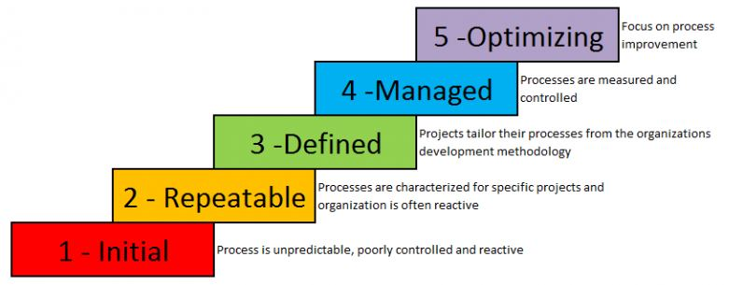
C M M M A T U R I T Y L E V E L S

Slide 31
5 LEVELS OF THE CAPABILITY MATURITY MODEL
Optimizing 18.4%
Managed 4.5%
Defined 32.9%
Repeatable 32.9%
Initial 2.2%
9.0%

Slide 32
CMMI Process Maturity Profile
SEI
CMMI v.1.1 Class A Appraisal Results
550
500
450
400
350
300
250
200
150
100
50
Based on most recent appraisal of 1,106 organizations , from 3/2002 – 12/2005 & reported by 1/2006. Incl.s results for system engineering, software engineering, integrated prod & process developm, & supplier sourcing
www.sei.cmu.edu/appraisal-program/profile/pdf/CMMI/2006marCMMI.pdf

Slide 33
I N I T I A L L E V E L -1
A software development organization at this level is characterized by ad hoc activities.
Very few or no processes are defined and followed. Since software production processes are not defined,
Different engineers follow their own process and as a result development efforts become chaotic. Therefore, it is also called chaotic level.
The success of projects depends on individual efforts and heroics.
When engineers leave, the successors have great difficulty in understanding the process followed and the work completed.

Slide 34
R E P E A T A B L E L E V E L-2
At this level, the basic project management practices such as tracking cost, schedule and functionality are established.
Size and cost estimation techniques like function point analysis, COCOMO, etc. are used.
The necessary process discipline is in place to repeat earlier success on projects with similar applications.
Please remember that opportunity to repeat a process exists only when a company produces a family of products.

Slide 35
D E F I N E D L E V E L - 3
At this level, processes for both management & development activities are defined & documented
Defining and implementing proven practices throughout the organization
Increased productivity, efficiency and effectiveness using these practices
Emergence of training group to provide organization-wide knowledge
ISO 9000 aims at achieving this level.

Slide 36
M A N A G E D L E V E L - 4
Management can effectively control the software development effort using precise measurements.
At this level, organization set a quantitative quality goal for both software process and software maintenance.
At this maturity level, the performance of processes is controlled using statistical and other quantitative techniques, and is quantitatively predictable.

Slide 37
O P T I M I Z I N G L E V E L -5
The Key characteristic of this level is focusing on continually improving process performance
through both incremental and innovative technological improvements.
For example, if from an analysis of the process measurement results, it was found that the code reviews were not very effective and a large number of errors were detected only during the unit testing,
then the process may be fine tuned to make the review more effective.

Slide 38
1.2 I S O 9 0 0 0

Slide 39
I N T R O D U C T I O N
International standards organization (ISO) is a association of 60 countries
It published a 9000 series standards in 1987
ISO 9000 std specifies the guidelines for maintaining quality of the system
It addresses operational aspects & organizational aspects
Responsibilities
Reporting
It specifies a set of recommendations for quality product development

Slide 40
I S O 9 0 0 0 S T A N D A R D S E R I E S
ISO 9000 is a series of 3 standards
ISO 9001
ISO 9002
ISO 9003
These series of standards are based on the premise that,
If proper process is followed for production, then good quality products are bound automatically

Slide 41
ISO 9001
This std is applied to organizations engaged in
Design
Development
Production
Servicing of goods
This std is applicable to most software development organizations
ISO 9002
This std is applied to those organizations which do not design products but only involved in production
E.g.: car manufacturing industries
Not applicable to s/w development organizations

Slide 42
ISO 9003
Applied to organizations involved in installation & testing of the products

Slide 43
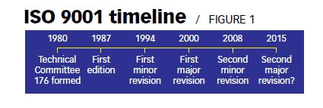

Slide 44
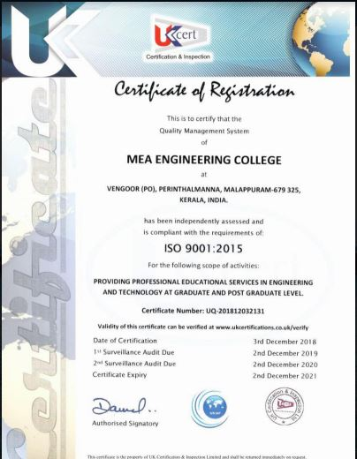
M E A I S O C E R T I F I E D

Slide 45
I S O 9 0 0 0 F O R S O F T W A R E I N D U S T R Y
It is a generic std applied to variety of industries
Many clauses in ISO 9000 are written using generic terminologies
It is very difficult to interpret for Software development organizations
Reason
Development of software products are different from development of other products

Slide 46
S O F T W A R E D E V E L O P M E N T VS O T H E R P R O D U C T D E V E L O P M E N T
Software is intangible and so its difficult to control
It is difficult to control & manage something which cannot be seen
Other products can be seen during its development
So it is easy to determine how much work is completed & can estimate how much more can be done
Raw material consumed during software development is data
Other products development involve large consumption of raw materials

Slide 47
I S O 9 0 0 0 – P A R T 3
Standard used to interpret clauses of ISO 9000 to software industry
Clauses of ISO 9000 are concerned with raw material control
This has no relevance in software development
Due to the differences of software development & other product development, it is difficult to interpret clauses of ISO in context of software industry
So ISO released a separate document called ISO 9000 part 3
This is to interpret ISO std to software industry

Slide 48
B E N E F I T S O F I S O C E R T I F I C A T I O N
Confidence of customers to an organization increases when organization qualify ISO certification
True in international markets
Organizations involved in software export takes this certification
ISO requires a well documented software production process
This increases the quality of the product
ISO makes development process focused, efficient & cost effective
Points out the weak points of organizations & recommends remedial action

Slide 49
H O W T O G E T I S O C E R T I F I C A T I O N ?
Organization intending to get ISO certification applies to ISO 9000 registrar for registration
ISO registration process have following stages
Application stage
Pre-assessment
Document review and adequacy audit
Compliance audit
Registration
Continued surveillance

Slide 50
H O W T O G E T I S O C E R T I F I C A T I O N ?
Application stage
Organization applies to registrar for registration
Pre-assessment
In this stage, registrar makes a rough assessment of the organizations
Document review & adequacy audit
In this stage registrar reviews the documents submitted by the organization
Makes suggestions for possible improvements
Compliance audit
In this stage, registrar checks whether the suggestions made by it during review have been satisfied or not
Registration
Registrar awards ISO 9000 certificate after successful completion of all previous phases
Continued surveillance
Registrar continues monitoring the organization periodically

Slide 51
F E A T U R E S O F I S O 9 0 0 1 R E Q U I R E M E N T S
Document control
All documents concerned with development of s/w product are properly
Managed
Authorized
Controlled
This requires a configuration management s/m
Planning
Proper plans must be prepared
Progress of against this plans must be monitored
Review
Important document on all phases must be independently checked & reviewed for correctness & effectiveness
Testing
Product is tested against specification
Organizational aspects
Organizational aspects like management reporting etc are conducted

Slide 52
S H O R T C O M I N G S O F I S O 9 0 0 0 C E R T I F I C A T I O N
It does not guarantee that the process is of high quality
No guideline is given for defining an appropriate process
ISO certification is not fool proof
No international accreditation agency
There can be variations in the norms of awarding certificates among different accreditation agencies
It does not automatically lead to continuous process improvement (TQM)

Slide 53
D I F F E R E N C E B E T W E E N I S O A N D C M M
ISO 9000 (INTERNATIONAL STANDARDS ORGANISATION) | CMM (CABABILITY MATURITY MODEL)
It applies to any type of industry. | CMM is specially developed for software industry.
ISO 9000 addresses corporate business process. | CMM focuses on the Software Engineering activities.
ISO 9000 specifies minimum requirement. | CMM gets into technical aspect of software engineering.
ISO 9000 restricts itself to what is required. | It suggests how to fulfill the requirements.
ISO 9000 provides pass or fail criteria. | It provides grade for process maturity.

Slide 54
ISO 9000 has no levels. | CMM has 5 levels: Initial Repeatable Defined Managed Optimization
ISO 9000 does not specify sequence of steps required to establish the quality system. | It reconnects the mechanism for step by step progress through its successive maturity levels.

Slide 55
2. P H A S E S I N S O F T W A R E D E V E L O P M E N T
2.1 Requirement analysis
2.2 Requirements elicitation for software
2.3 Analysis principles
2.4 Software prototyping
2.5 Requirement Specification

Slide 56
2.1 R E Q U I R E M E N T S E N G I N E E R I N G

Slide 57
I N T R O D U C T I O N
The goal of the requirements engineering process is to create and maintain a system requirements document.
The overall process includes four stages
Feasibility study
Requirement elicitation and analysis
Requirement specification
Requirement validation

Slide 58
I N T R O D U C T I O N
Feasibility study
Checking whether the system is useful to the business
Requirement elicitation & analysis
Discovering requirements
Requirement specification
Converting these requirements into some standard form
Requirement validation
Checking that the requirements actually define the system that the customer wants
Documents are produced at each stage of the requirements engineering process.

Slide 59
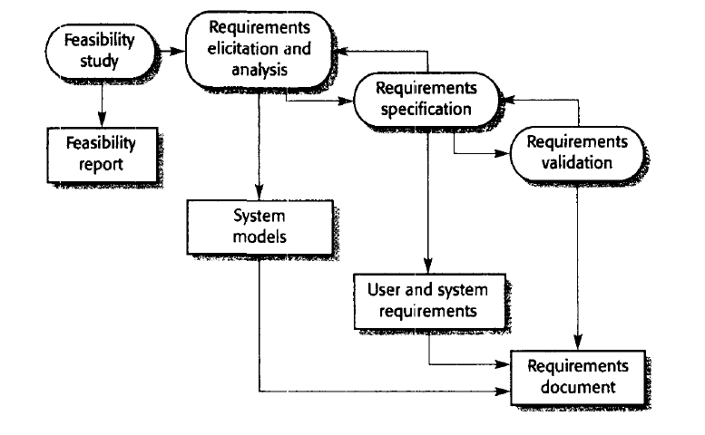

Slide 60
F E A S I B I L I T Y S T U D Y
The input to the feasibility study is
A set of preliminary business requirements
An outline description of the system
How the system is intended to support business process

Slide 61
A I M O F F E A S I B I L I T Y S T U D Y
It answers the following questions
Does the system contribute to the overall objectives of the organization?
Can the system be implemented using current technology and within given cost and schedule constraints?
Can the system be integrated with other systems which are already in place?
Answer to the first question is critical
If s/m does not support business objectives, then it has no value in business

Slide 62
P H A S E S O F F E A S I B I L I T Y S T U D Y
3 phases
Information collection
Information assessment
Report writing

Slide 63
I N F O R M A T I O N C O L L E C T I O N
Information is collected from various sources
Information sources can be
Managers of the department where the system will be used
Software engineers who are familiar with the type of system that is proposed
Technology experts and end-users of the system

Slide 64
I N F O R M A T I O N A S S E S S M E N T P H A S E
Identifies the information that is required to answer the three questions set out above.
Talk with information sources to discover the answers to these questions.
Information sources can be
Managers of the department where the system will be used,
software engineers who are familiar with the type of system that is proposed,
technology experts and end-users of the system

Slide 65
R E P O R T W R I T I N G
After obtaining the information, feasibility study report is written.
Make a recommendation about whether or not the system development should continue.
Propose changes to the scope, budget and schedule of the system
Suggest further high-level requirements for the system.

Slide 66
2.2 R E Q U I R E M E N T E L I C I T A T I O N & A N A L Y S I S

Slide 67
I N T R O D U C T I O N
After an initial feasibility study, the next stage of the requirements engineering process is requirements elicitation and analysis
In this activity, software engineers work with customers and system end-users
Communication is done to find out about
Application domain
What services the system should provide
The required performance of the system
Hardware constraints

Slide 68
S T A K E H O L D E R S
Requirements elicitation and analysis may involve a variety of people in an organization
The term stakeholder is used to refer to any person or group who will be affected by the system, directly or indirectly.
Stakeholders include
End-users who interact with the system
Everyone else in an organization that may be affected by its installation
Engineers who are developing or maintaining related systems
Business managers
Domain experts
Trade union representatives.

Slide 69
REASONS FOR POOR ELICITATION OF REQUIREMENTS FROM STAKEHOLDERS
Stakeholders often don't know what they want from the computer system
They may find it difficult to articulate what they want the system to do
make unrealistic demands because they are unaware of the cost of their requests.
They express requirements in their own terms with implicit knowledge of their own work.
Requirements engineers, without experience in the customer's domain, find these difficult to understand these requirements.

Slide 70
Different stakeholders have different requirements, & they may express in different ways.
Requirements engineers have to consider all potential sources of requirements
discover commonalities and conflict.
Political factors may influence the requirements of the system.
Managers may demand specific system requirements that will increase their influence in the organization.
The economic and business environment in which the analysis takes place is dynamic.
This changes the analysis process.
Hence the importance of particular requirements may change.
New requirements may emerge from new stakeholders who were not originally consulted.

Slide 71
A C T I V I T I E S O F R E Q U I R E M E N T E L I C I T A T I O N & A N A L Y S I S
Requirement discovery
Requirement classification & organization
Requirement prioritization & negotiation
Requirement Documentation

Slide 72
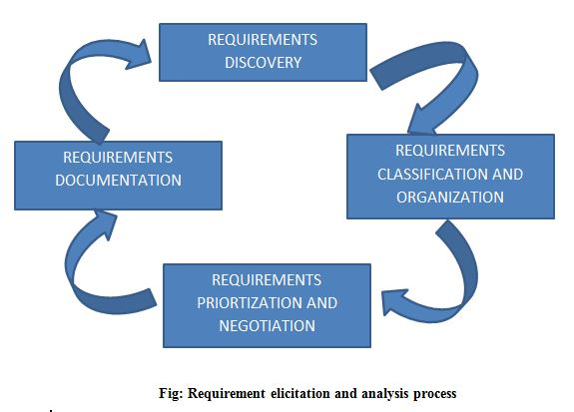
A C T I V I T I E S O F R E Q U I R E M E N T E L I C I T A T I O N & A N A L Y S I S

Slide 73
R E Q U I R E M E N T D I S C O V E R Y
This is the process of interacting with stakeholders in the system
Interaction is done to collect their requirements.
It is the process of gathering information about the proposed and existing systems
Analyze the user and system requirements from these information.

Slide 74
T E C H N I Q U E S / M E T H O D S F O R R E Q U I R E M E N T D I S C O V E R Y
Interview
Surveys
Questionnaires
Brainstorming
Prototyping
Use cases
Observation

Slide 75
1. I N T E R V I E W
Interviews are strong medium to collect requirements. Organization may conduct several types of interviews such as:
Structured (closed) interviews, where every single information to gather is decided in advance, they follow pattern and matter of discussion firmly.
Non-structured (open) interviews, where information to gather is not decided in advance, more flexible and less biased.
Oral interviews
Written interviews
One-to-one interviews which are held between two persons across the table.
Group interviews which are held between groups of participants. They help to uncover any missing requirement as numerous people are involved.

Slide 76
2. S U R V E Y S
Organization may conduct surveys among various stakeholders by querying about their expectation and requirements from the upcoming system.

Slide 77
3. Q U E S T I O N N A I R E S
A document with pre-defined set of objective questions and respective options is handed over to all stakeholders to answer, which are collected and compiled.
A shortcoming of this technique is, if an option for some issue is not mentioned in the questionnaire, the issue might be left unattended.

Slide 78
4. B R A I N S T O R M I N G
An informal debate is held among various stakeholders and all their inputs are recorded for further requirements analysis.

Slide 79
5. P R O T O T Y P I N G
Prototyping is building user interface without adding detail functionality for user to interpret the features of intended software product.
It helps giving better idea of requirements

Slide 80
6. U S E C A S E S
Use cases are a requirements discovery technique that were first introduced in the objectory method and they have now become a fundamental feature of the Unified Modeling Language (UML).
In their simplest form, a use case identifies the actors involved in an interaction and names the type of interaction.
Actors in the process, who may be human or other systems, are represented as stick figures.
Each class of interaction is represented as a named ellipse.
Lines link the actors with the interaction.
Use cases identify the individual interactions between the system and its users or other systems.

Slide 81
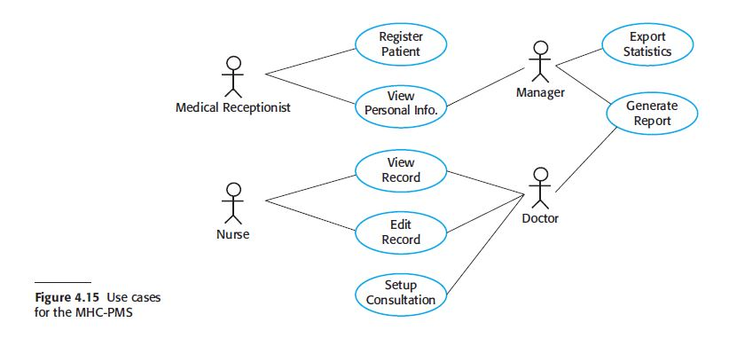
U S E C A S E S

Slide 82
7. O B S E R V A T I O N
Team of experts visit the client’s organization or workplace.
They observe the actual working of the existing installed systems.
They observe the workflow at client’s end and how execution problems are dealt.
The team itself draws some conclusions which aid to form requirements expected from the software.

Slide 83
R E Q U I R E M E N T C L A S S I F I C A T I O N & O R G A N I Z A T I O N
This activity takes the unstructured collection of requirements
Groups the related requirements
Organizes these requirements into coherent clusters.

Slide 84
R E Q U I R E M E N T P R I O R I T I Z A T I O N & N E G O T I A T I O N
When multiple stakeholders are involved, requirements will conflict.
This activity is concerned with prioritizing requirements
Find out and resolve requirements conflicts through negotiation.

Slide 85
R E Q U I R E M E N T S D O C U M E N T A T I O N
The requirements are documented
They are inputted into the next round of the spiral.
Formal or informal requirements documents may be produced.

Slide 86
2.4 S O F T W A R E P R O T O T Y P I N G

Slide 87
I N T R O D U C T I O N
The Software Prototyping refers to building software application prototypes which displays the functionality of the product under development, but may not actually hold the exact logic of the original software.
Software prototyping is becoming very popular as a software development model, as it enables to understand customer requirements at an early stage of development.
It helps get valuable feedback from the customer and helps software designers and developers understand about what exactly is expected from the product under development.
Prototype is a working model of software with some limited functionality.

Slide 88
S O F T W A R E P R O T O T Y P I N G – T Y P E S
Throwaway/Rapid Prototyping
Evolutionary Prototyping
Incremental Prototyping

Slide 89
T H R O W A W A Y/ R A P I D P R O T O T Y P I N G
Throwaway prototyping is also called as rapid or close ended prototyping.
This type of prototyping uses very little efforts with minimum requirement analysis to build a prototype.
Once the actual requirements are understood, the prototype is discarded and the actual system is developed with a much clear understanding of user requirements.

Slide 90
E V O L U T I O N A R Y P R O T O T Y P I N G
Evolutionary prototyping also called as breadboard prototyping is based on building actual functional prototypes with minimal functionality in the beginning.
The prototype developed forms the heart of the future prototypes on top of which the entire system is built.
By using evolutionary prototyping, the well-understood requirements are included in the prototype and the requirements are added as and when they are understood.

Slide 91
I N C R E M E N T A L P R O T O T Y P I N G
Incremental prototyping refers to building multiple functional prototypes of the various sub-systems and then integrating all the available prototypes to form a complete system.

Slide 92
2.5 R E Q U I R E M E N T S P E C I F I C A T I O N

Slide 93
I N T R O D U C T I O N
Requirements
The requirements for a system are the descriptions of the services provided by the system and its operational constraints.
Requirements reflect the needs of customers for a system
It is a detailed formal definition of a system function

Slide 94
C L A S S I F I C A T I O N O F R E Q U I R E M E N T S
User requirements
System requirements

Slide 95
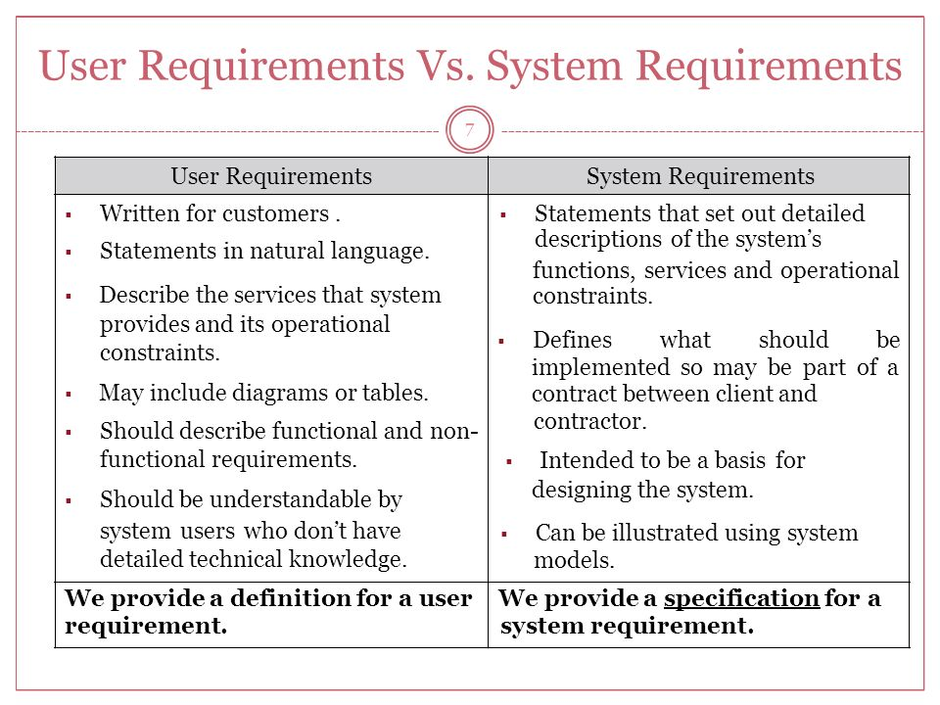

Slide 96
C L A S S I F I C A T I O N O F S Y S T E M R E Q U I R E M E N T S
Functional requirements
Non functional requirements

Slide 97
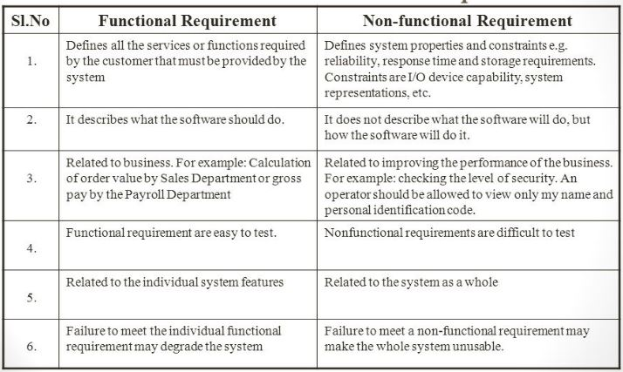
FUNCTIONAL REQUIREMENT VS NON-FUNCTIONAL REQUIREMENT

Slide 98
TYPES OF NON FUNCTIONAL REQUIREMENTS
Product requirements
Organizational requirements
External requirements

Slide 99
PRODUCT REQUIREMENTS
Requirements which specify that the delivered product must behave in a particular way
E.g. execution speed, reliability, etc.

Slide 100
ORGANIZATIONAL REQUIREMENT
Requirements which are a consequence of organizational policies and procedures
E.g. process standards used, implementation requirements, etc.

Slide 101
EXTERNAL REQUIREMENTS
They are derived from factors external to the system and its development process.
They include:
Interoperability requirements
that define how the system interacts with systems in other organizations
Legislative requirements.
They are followed to ensure that the system operates within the law.
Ethical requirements
requirements placed on a system to ensure that it will be acceptable to its users and the general public.

Slide 102
S O F T W A R E R E Q U I R E M E N T S P E C I F I C A T I O N D O C U M E N T ( S R S)

Slide 103
Introduction
After requirement gathering & analysis, analyst systematically organize requirements in the form of SRS document
SRS document contains all the requirements in a structured form
Most important document & toughest to write
SRS is expected to cater needs of a wide variety of audience

Slide 104
USERS OF SRS DOCUMENT
Large no: of people need SRS document for various purposes
Users & customers
Marketing personnel
Software developers
Test engineers
User document writers
Project managers
Maintenance engineers

Slide 105
U S E R S O F S R S D O C U M E N T
Users & customers
They need SRS to ensure that system described in the document will meet their needs or not.
Marketing professionals
In case of generic products, Marketing personnel need to understand requirements if they want to explain them to customers.

Slide 106
U S E R S O F S R S D O C U M E N T
Software developers
They refer SRS to make sure that they are designing exactly what is required by the customer.
Test engineers
They use SRS to understand the functionalities of s/w
Based on this they write test cases to validate its working
I/P and O/P data is identified precisely

Slide 107
U S E R S O F S R S D O C U M E N T
User documentation writers
They need to read the SRS & understand the features, to prepare the user’s manual
Project managers
They need to read the SRS so that they can estimate the cost of the project easily
SRS contains all information to plan the project

Slide 108
U S E R S O F S R S D O C U M E N T
Maintenance engineers
SRS helps the maintenance engineers to understand the functionalities supported by system
This helps them to understand code & design
This helps them to determine the modifications to s/m functionalities

Slide 109
OTHER USES OF SRS
S/w engineers consider SRS as a reference document
SRS act as a contract b/w customers and development team
Used to resolve any disagreements b/w developers & customers
Used as a legal document to settle disputes

Slide 110
IMPORTANT USES OF WELL FORMULATED SRS DOCUMENT
Forms an agreement b/w customers & developers
Reduces future reworks
Provides a basis for estimating costs & schedules
Provides a baseline for validation & verification
Facilitate future extensions

Slide 111
CHARACTERISTICS OF A GOOD SRS DOCUMENT
Concise
Implementation independent
Traceable
Modifiable
Response to undesirable events
Verifiable

Slide 112
C O N C I S E
SRS should be concise, unambiguous, consistent and complete
Verbose & irrelevant descriptions reduce readability & increases possibility of errors

Slide 113
I M P L E M E N T A T I O N I N D E P E N D E N T
SRS should be free of design & implementation decisions
It should only specify what the s/m should do & should not state how to do these
SRS specify only the externally visible behavior of s/m, & not discuss implementation issues
So it is also called as black box specification of s/w

Slide 114
T R A C E A B L E
It should be possible to trace the specific requirement to design elements that implement it & vice versa
Traceability is important to verify results of a phase w.r.t the previous phase

Slide 115
M O D I F I A B L E
Customers changes requirements frequently during development
So SRS undergoes several revisions during development
To cope with this requirement changes, SRS has to be easily modifiable
For that SRS should be well structured
Well structured document is easy to modify & understand

Slide 116
R E S P O N S E T O U N D E S I R E D E V E N T S
SRS should discuss the s/m responses to various undesired events & exceptional conditions that may arise

Slide 117
V E R I F I A B L E
All requirements in SRS document must be verifiable
It should be possible to design test cases based on the description of functionality

Slide 118

S O F T W A R E R E Q U I R E M E N T S P E C I F I C A T I O N D O C U M E N T ( S R S)

Slide 119
S O F T W A R E R E Q U I R E M E N T S P E C I F I C A T I O N D O C U M E N T ( S R S)
Parts of a SRS Documents are
Functional requirements
Non-functional requirements
Goal of implementation

Slide 120

FUNCTIONAL REQUIREMENTS

Slide 121
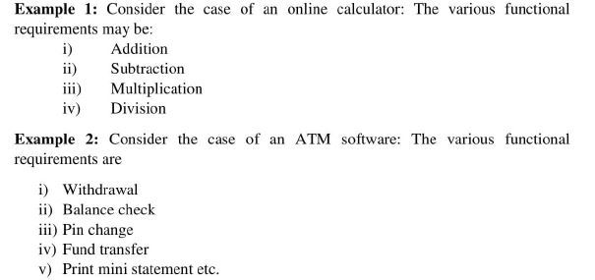
FUNCTIONAL REQUIREMENTS

Slide 122
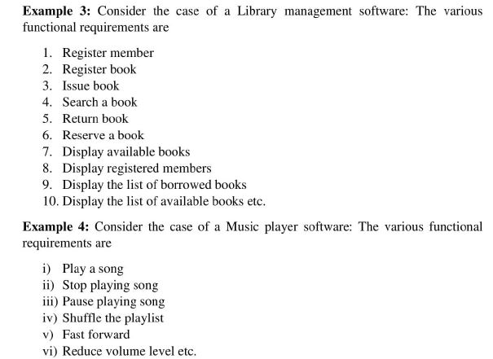
FUNCTIONAL REQUIREMENTS

Slide 123
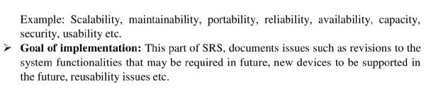
NON-FUNCTIONAL REQUIREMENTS

Slide 124

GOAL OF IMPLEMENTATION

Slide 125
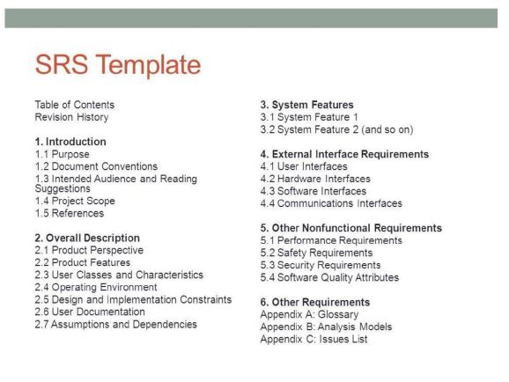
SRS Template

Slide 126
EXAMPLE
An Engineering college decided to automate their library procedures. Prepare Software Requirement Specification for the proposed software in IEEE format.

Slide 127
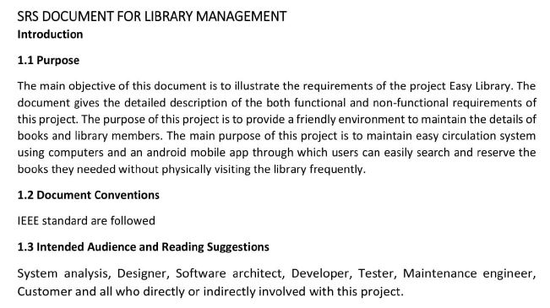

Slide 128
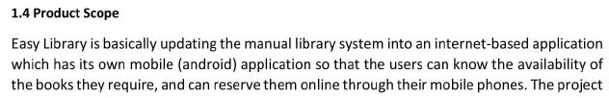
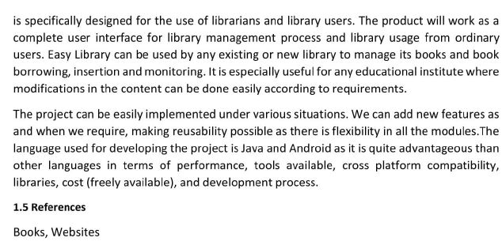

Slide 129
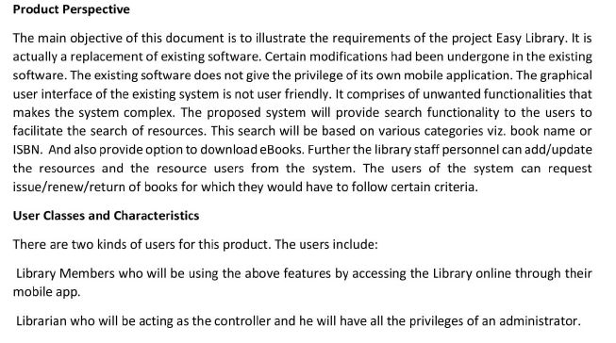
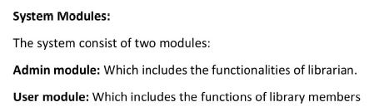

Slide 130

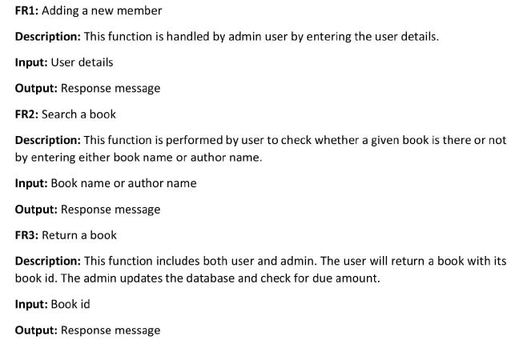

Slide 131
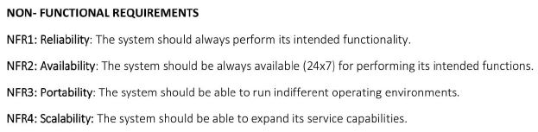

Slide 132
